Slide 1

Real Estate
Documentation

Slide 2

Table of Content
Slide 3 Overview
Slide 4 Vertical Bar Chat of Total Sale per Quarter of the Real Estate
Slide 5 Horizontal Bar Chat of Total Sale per Quarter of the Real Estate
Slide 6 Stacked Bar Chart of Quarterly Sales Prices
Slide 7 Bar Chart of Monthly Sales
Slide 8 Stacked Bar Chart of Monthly Sales Prices by Year
Slide 9 Scatter Plot of Average Sales Price by Total Finished Area
Slide 10 Conclusion
Slide 11 Recommendation

Slide 3

overview
This presentation gives an insight into the sales in real estate between August 2018 and August 2020.

Slide 4
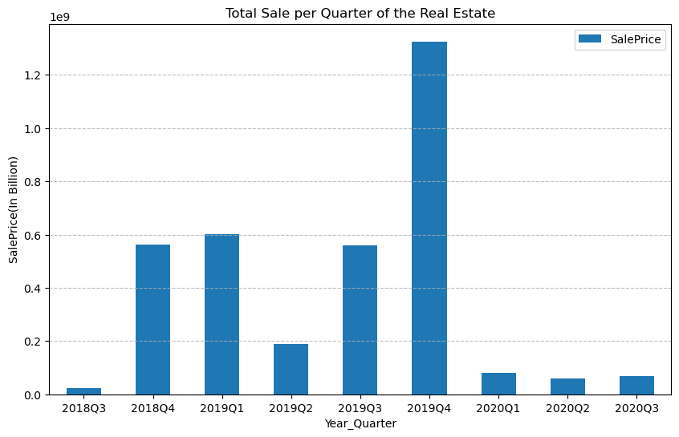
Vertical Bar Chat of Total Sale per Quarter of the Real Estate

Slide 5
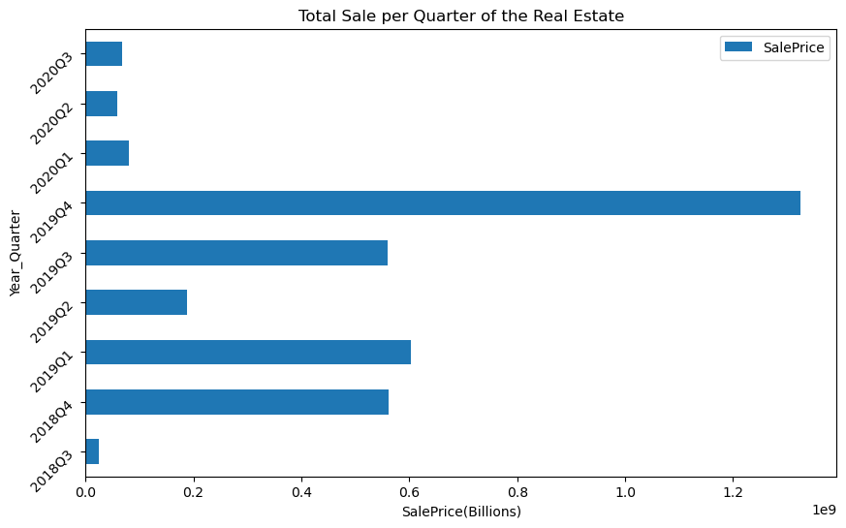
Horizontal Bar Chat of Total Sale per Quarter of the Real Estate

Slide 6
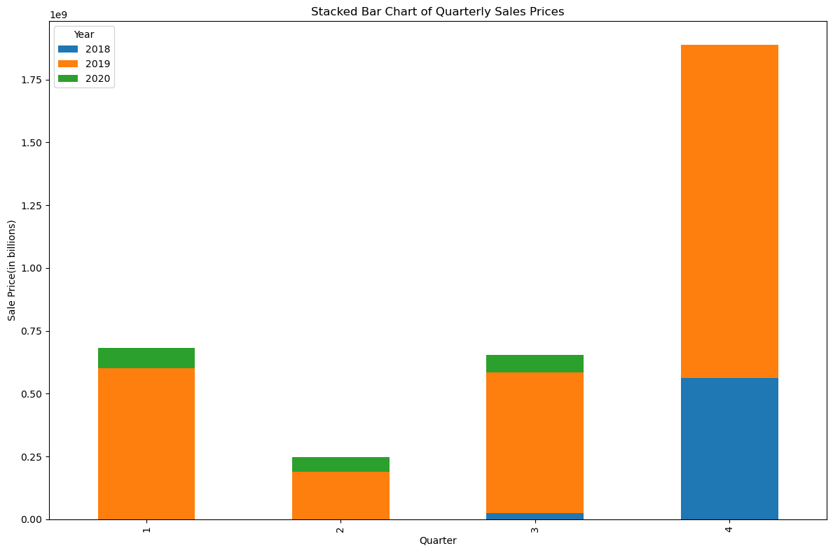
Stacked Bar Chart of Quarterly Sales Prices

Slide 7
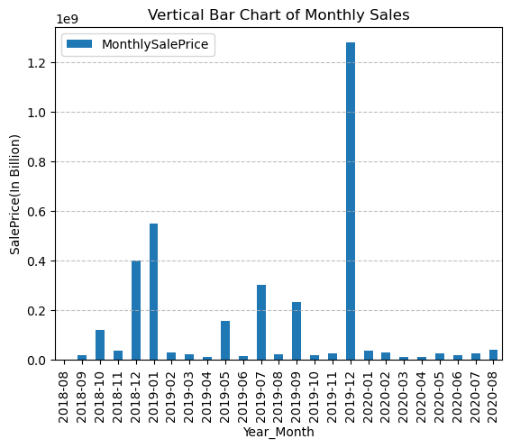
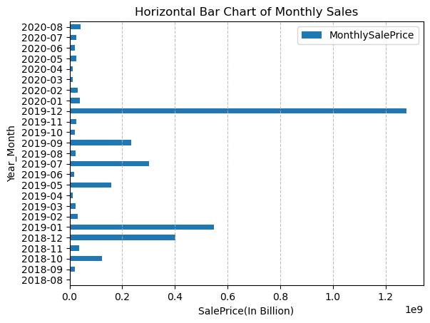
Bar Chart of Monthly Sales

Slide 8
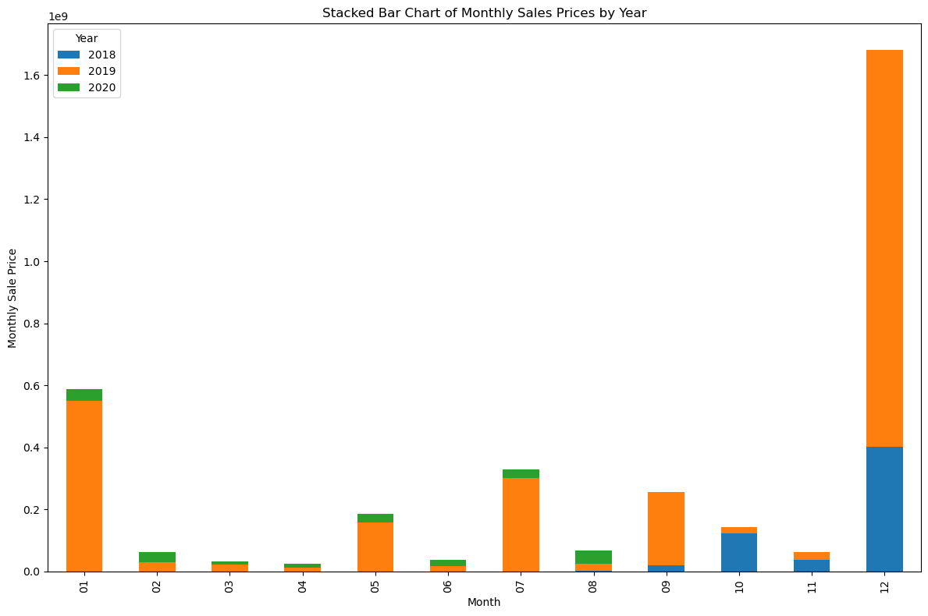
Stacked Bar Chart of Monthly Sales Prices by Year

Slide 9
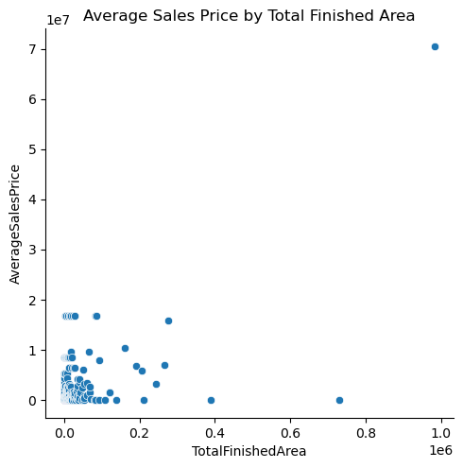
Scatter Plot of Average Sales Price by Total Finished Area

Slide 10
Conclusion
There is a significant spike in sales during the fourth quarter (Q4) of each year, particularly in 2018 and 2019. For instance, Q4 of 2018 had sales of 561,895,007, and Q4 of 2019 had even higher sales at 1,325,446,723. The spikes in Q4 sales could be attributed to seasonal factors like holiday shopping, end-of-year promotions and end of year spending.
Q3 of 2018 (24,350,918) and Q3 of 2019 (560,335,327), reveals substantial growth in sales from one year to the next. However, there is a notable drop in sales in 2020, starting from Q1 (80,792,514) and continuing with lower figures in subsequent quarters. The first quarter of 2019 shows a high sales figure (602,120,437), indicating strong sales activity early in the year. Conversely, 2020 Q1 shows a significant decline potentially indicating a slowdown in sales activity. The decline in sales in 2020 may be related to broader economic conditions, such as the impact of the COVID-19 pandemic, which affected many industries globally.
The beginning of 2019 shows a very high sales figure in January (549,315,095), indicating a strong start to the year. December 2019 also shows a substantial increase (1,278,625,719), much higher than other months, similar to the pattern seen in December 2018. There are noticeable spikes in certain months, such as October 2018 (122,519,616) and July 2019 (302,585,613). Conversely, some months like April 2019 (12,936,501) and March 2020 (10,851,262) have relatively low sales figures.

Slide 11
Recommendation
Keep a close watch on market trends and adjust business strategies accordingly. Stay informed about economic indicators that might affect the real estate market.
Diversify the real estate portfolio to include properties that might be in demand even during economic downturns, such as affordable housing or commercial real estate with long-term leases.
Plan promotions and incentives for peak seasons to maximize sales. Consider offering discounts or special deals in slower months to boost transactions.
Consider flexible financing options and targeted incentives to attract buyers during the economic downturn.

